Slide 1
First
Thessalonians

Slide 2
1 Thessalonians 2:4-6
“But as we have been approved by God to be entrusted with the gospel, even so we speak, not as pleasing men, but God who tests our hearts. For neither at any time did we use flattering words, as you know, nor a cloak for covetousness – God is witness. Nor did we seek glory from men, either from you or from others, when we might have made demands as apostles of Christ.”

Slide 3
Acts 14:8-18
“And in Lystra a certain man without strength in his feet was sitting, a cripple from his mother’s womb, who had never walked. This man heard Paul speaking. Paul, observing him intently and seeing that he had faith to be healed, said with a loud voice, “Stand up straight on your feet!”

Slide 4
Acts 14:8-18
And he leaped and walked. Now when the people saw what Paul had done, they raised their voices, saying in the Lycaonian language, “The gods have come down to us in the likeness of men!” And Barnabas they called Zeus, and Paul, Hermes, because he was the chief speaker.

Slide 5
Acts 14:8-18
Then the priest of Zeus, whose temple was in front of their city, brought oxen and garlands to the gates, intending to sacrifice with the multitudes. But when the apostles Barnabas and Paul heard this, they tore their clothes and ran in among the multitude, crying out and saying, “Men, why are you doing these things?

Slide 6
Acts 14:8-18
We also are men with the same nature as you, and preach to you that you should turn from these useless things to the living God, who made the heaven, the earth, the sea, and all things that are in them, who in bygone generations allowed all nations to walk in their own ways.”

Slide 7
1 Thessalonians 2:7-9
“But we were gentle among you, just as a nursing mother cherishes her own children. So, affectionately longing for you, we were well pleased to impart to you not only the gospel of God, but also our own lives, because you had become dear to us. For you remember, brethren, our labor and toil; for laboring night and day, that we might not be a burden to any of you, we preached to you the gospel of God.”

Slide 8
1 Thessalonians 2:7-9
“But we were gentle among you, just as a nursing mother cherishes her own children. So, affectionately longing for you, we were well pleased to impart to you not only the gospel of God, but also our own lives, because you had become dear to us. For you remember, brethren, our labor and toil; for laboring night and day, that we might not be a burden to any of you, we preached to you the gospel of God.”

Slide 9
1 Thessalonians 2:7-9
“But we were gentle among you, just as a nursing mother cherishes her own children. So, affectionately longing for you, we were well pleased to impart to you not only the gospel of God, but also our own lives, because you had become dear to us. For you remember, brethren, our labor and toil; for laboring night and day, that we might not be a burden to any of you, we preached to you the gospel of God.”

Slide 10
1 Thessalonians 2:7-9
“But we were gentle among you, just as a nursing mother cherishes her own children. So, affectionately longing for you, we were well pleased to impart to you not only the gospel of God, but also our own lives, because you had become dear to us. For you remember, brethren, our labor and toil; for laboring night and day, that we might not be a burden to any of you, we preached to you the gospel of God.”

Slide 11
God gives the believer in His Son, Jesus Christ His very life, too … His Holy Spirit to indwell him at the moment of belief.

Slide 12
2 Corinthians 1:21-22
“Now He who establishes us with you in Christ and has anointed us is God, who also has sealed us and given us the Spirit in our hearts as a guarantee.”

Slide 13
2 Corinthians 5:1-5
“For we know that if our earthly house, this tent, is destroyed, we have a building from God, a house not made with hands, eternal in the heavens. For in this we groan, earnestly desiring to be clothed with our habitation which is from heaven, if indeed, having been clothed, we shall not be found

Slide 14
2 Corinthians 5:1-5
naked. For we who are in this tent groan, being burdened, not because we want to be unclothed, but further clothed, that mortality may be swallowed up by life. Now He who has prepared us for this very thing is God, who also has given us the Spirit as a guarantee.”

Slide 15
2 Corinthians 5:1-5 (NLT)
“For we know that when this earthly tent we live in is taken down (that is, when we die and leave this earthly body), we will have a house in heaven, an eternal body made for us by God Himself and not by human hands. We grow weary in our present bodies, and we long to put on our heavenly bodies like new clothing. For we will put on heavenly bodies; we will not be

Slide 16
2 Corinthians 5:1-5 (NLT)
spirits without bodies. While we live in these earthly bodies, we groan and sigh, but it’s not that we want to die and get rid of these bodies that clothe us. Rather, we want to put on our new bodies so that these dying bodies will be swallowed up by life. God Himself has prepared us for this, and as a guarantee He has given us His Holy Spirit.”

Slide 17
Ephesians 1:13-14
“In Him you also trusted, after you heard the word of truth, the gospel of your salvation; in whom also, having believed, you were sealed with the Holy Spirit of promise, who is the guarantee of our inheritance until the redemption of the purchased possession, to the praise of His glory.”

Slide 18
Ephesians 4:30
“And do not grieve the Holy Spirit of God, by whom you were sealed for the day of redemption.”

Slide 19
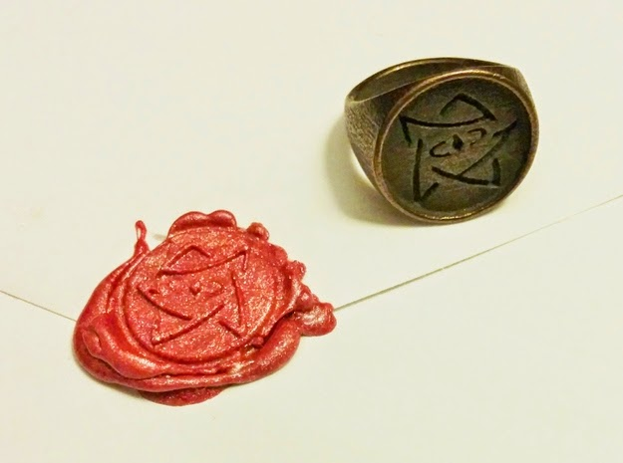

Slide 20
Ephesians 4:30
“And do not grieve the Holy Spirit of God, by whom you were sealed for the day of redemption.”

Slide 21
If you are here this morning and you believe you are a saved individual, but yet you also have doubts as to whether or not your belief absolutely, 100% guarantees that you will be in the presence of Jesus Christ for all of eternity …

Slide 22
Maybe you have never totally
thought through what God
has promised when
one believes in His Son.

Slide 23
John 3:16
“For God so loved the world that He gave His only begotten Son, that whoever believes in Him should not perish but have everlasting life.”
John 6:47
“… he who believes in Me has everlasting life.”

Slide 24
Maybe you may think there is some kind of sin you can commit that will negate the promise that God has made.

Slide 25
The integrity of God’s veracity would be at stake!

Slide 26
The integrity of God’s veracity would be at stake!
There must be a deep misunderstanding of God’s redemption and forgiveness of sin.

Slide 27
Ephesians 1:7
“In Him we have redemption through His blood, the forgiveness of sins, according to the riches of His grace.”

Slide 28
1 John 2:1-2
“My little children, these things I write to you, so that you may not sin. And if anyone sins, we have an Advocate with the Father, Jesus Christ the righteous. And He Himself is the propitiation (satisfaction) for our sins, and not for ours only but also for the whole world.”

Slide 29
Maybe you have doubts regarding what you think is the sincerity of your own faith.

Slide 30
Ephesians 2:8-9
“For by grace you have been saved through faith, and that not of yourselves; it is the gift of God, not of works, lest anyone should boast.”

Slide 31
Ephesians 2:4-5
“But God, who is rich in mercy, because of His great love with which He loved us, even when we were dead in trespasses, made us alive together with Christ (by grace you have been saved) …”.

Slide 32
James 2:26
“For as the body without the spirit is dead, so faith without works is dead also.”

Slide 33
“πίστις”, “pistis” (G4102)
Strong’s defines it as:
“persuasion that is credence; moral conviction (of religious truth or the truthfulness of God or a religious teacher) especially reliance upon Christ for salvation”.

Slide 34
“πίστις”, “pistis” (G4102)
Thayer’s defines it this way:
Conviction of the truth of anything, belief …
a. relating to God
1. The conviction that God exists and is the creator and ruler of all things, the provider and bestower of eternal salvation through Christ
b. relating to Christ
1. A strong and welcome conviction or belief that Jesus is the Messiah, through whom we obtain eternal salvation in the kingdom of God.”

Slide 35


Ephesians 2:8-9
“For by grace you have been saved through faith, and that not of yourselves; it is the gift of God, not of works, lest anyone should boast.”
“πίστις”, “pistis”

Slide 36
“πιστεύω”, “pisteuō” (G4100)
Thayer’s defines it as:
“to think to be true, to be persuaded of, to credit, place confidence in … to trust in Jesus or God as able to aid either in obtaining or in doing something: saving faith.”

Slide 37
The word, “believe,” doesn’t convey multiple meanings. Basically, you either believe something or you don’t. There is no middle ground. If there is even the slightest bit of doubt in one’s mind about something, then it is understood that you don’t believe it.

Slide 38
The only goodness and works that count is the goodness of Christ and the work that He accomplished for us on the Cross of Calvary ... PERIOD!

