Slide 1
First
Thessalonians

Slide 2
1 Thessalonians 3:10
“… night and day praying exceedingly that we may see your face and perfect what is lacking in your faith …”.

Slide 3
1 Thessalonians 3:11-13
“Now may our God and Father Himself, and our Lord Jesus Christ, direct our way to you. And may the Lord make you increase and abound in love to one another and to all, just as we do to you, so that He may establish your hearts blameless in holiness before our God and Father at the coming of our Lord Jesus Christ with all His saints.”

Slide 4
1 Thessalonians 3:11-13
“Now may our God and Father Himself, and our Lord Jesus Christ, direct our way to you. And may the Lord make you increase and abound in love to one another and to all, just as we do to you, so that He may establish your hearts blameless in holiness before our God and Father at the coming of our Lord Jesus Christ with all His saints.”

Slide 5
Matthew 26:39
“He went a little farther and fell on His face, and prayed, saying, “O My Father, if it is possible, let this cup pass from Me; nevertheless, not as I will, but as You will.”

Slide 6
Matthew 26:39
“He went a little farther and fell on His face, and prayed, saying, “O My Father, if it is possible, let this cup pass from Me; nevertheless, not as I will, but as You will.”
Verse 42 …
“Again, a second time, He went away and prayed, saying, “O My Father, if this cup cannot pass away from Me unless I drink it, Your will be done.”

Slide 7
Galatians 1:1-5
“Paul, an apostle (not from men nor through man, but through Jesus Christ and God the Father who raised Him from the dead), and all the brethren who are with me, to the churches of Galatia: Grace to you and peace from God the Father and our Lord Jesus Christ, who gave Himself for our sins, that He might deliver us from this present evil age, according to the will of our God and Father, to whom be glory forever and ever. Amen.”

Slide 8
Galatians 1:1-5
“Paul, an apostle (not from men nor through man, but through Jesus Christ and God the Father who raised Him from the dead), and all the brethren who are with me, to the churches of Galatia: Grace to you and peace from God the Father and our Lord Jesus Christ, who gave Himself for our sins, that He might deliver us from this present evil age, according to the will of our God and Father, to whom be glory forever and ever. Amen.”

Slide 9
1 Thessalonians 3:11-13
“Now may our God and Father Himself, and our Lord Jesus Christ, direct our way to you. And may the Lord make you increase and abound in love to one another and to all, just as we do to you, so that He may establish your hearts blameless in holiness before our God and Father at the coming of our Lord Jesus Christ with all His saints.”

Slide 10
1 Thessalonians 3:11-13
“Now may our God and Father Himself, and our Lord Jesus Christ, direct our way to you. And may the Lord make you increase and abound in love to one another and to all, just as we do to you, so that He may establish your hearts blameless in holiness before our God and Father at the coming of our Lord Jesus Christ with all His saints.”

Slide 11
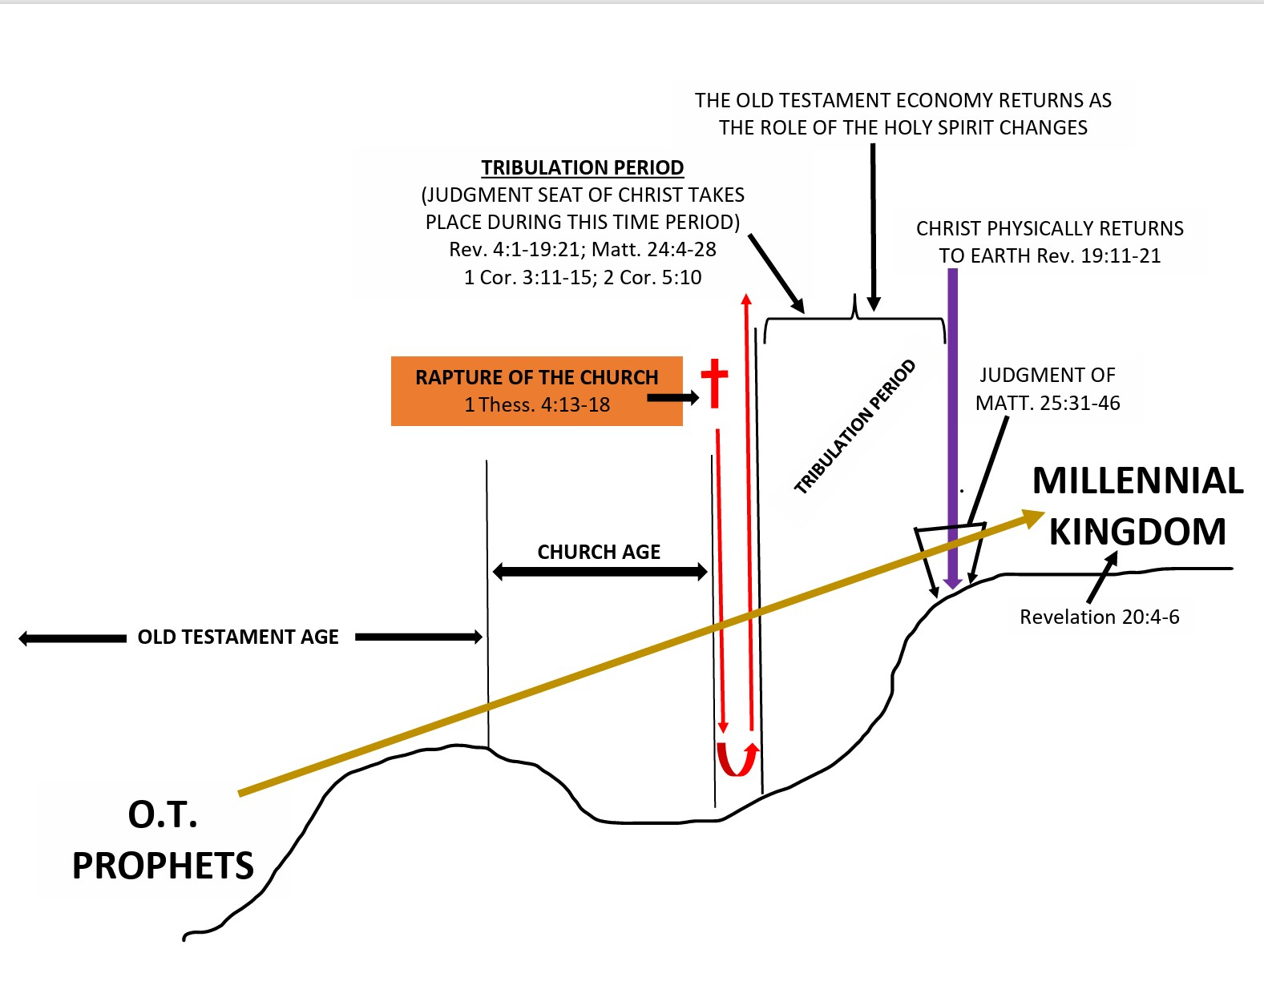


Slide 12
Maybe here

Slide 13
1 Thessalonians 3:11-13
“Now may our God and Father Himself, and our Lord Jesus Christ, direct our way to you. And may the Lord make you increase and abound in love to one another and to all, just as we do to you, so that He may establish your hearts blameless in holiness before our God and Father at the coming of our Lord Jesus Christ with all His saints.”

Slide 14
1 Thessalonians 3:11-13
“Now may our God and Father Himself, and our Lord Jesus Christ, direct our way to you. And may the Lord make you increase and abound in love to one another and to all, just as we do to you, so that He may establish your hearts blameless in holiness before our God and Father at the coming of our Lord Jesus Christ with all His saints.”

Slide 15
1 Thessalonians 3:11-13
“Now may our God and Father Himself, and our Lord Jesus Christ, direct our way to you. And may the Lord make you increase and abound in love to one another and to all, just as we do to you, so that He may establish your hearts blameless in holiness before our God and Father at the coming of our Lord Jesus Christ with all His saints.”

Slide 16
1 Thessalonians 3:11-13
“Now may our God and Father Himself, and our Lord Jesus Christ, direct our way to you. And may the Lord make you increase and abound in love to one another and to all, just as we do to you, so that He may establish your hearts blameless in holiness before our God and Father at the coming of our Lord Jesus Christ with all His saints.”

Slide 17
Revelation 19:11-16
“Now I saw heaven opened, and behold, a white horse. And He who sat on him was called Faithful and True, and in righteousness He judges and makes war. His eyes were like a flame of fire, and on His head were many crowns. He had a name written that no one knew except Himself. He was clothed with a robe

Slide 18
Revelation 19:11-16
dipped in blood, and His name is called The Word of God. And the armies in heaven, clothed in fine linen, white and clean, followed Him on white horses. Now out of His mouth goes a sharp sword, that with it He should strike the nations. And He Himself will rule them with a rod of iron.

Slide 19
Revelation 19:11-16
He Himself treads the winepress of the fierceness and wrath of Almighty God. And He has on His robe and on His thigh a name written: KING OF KINGS AND LORD OF LORDS.”

Slide 20
Revelation 19:11-16
dipped in blood, and His name is called The Word of God. And the armies in heaven, clothed in fine linen, white and clean, followed Him on white horses. Now out of His mouth goes a sharp sword, that with it He should strike the nations. And He Himself will rule them with a rod of iron.

Slide 21
Revelation 17:12-14
“The ten horns which you saw are ten kings who have received no kingdom as yet, but they receive authority for one hour as kings with the beast. These are of one mind, and they will give their power and authority to the beast. These will make war with the Lamb, and the Lamb will overcome them, for He is Lord of lords and King of kings; and those who are with Him are called, chosen, and faithful.”

Slide 22
Revelation 17:12-14
“The ten horns which you saw are ten kings who have received no kingdom as yet, but they receive authority for one hour as kings with the beast. These are of one mind, and they will give their power and authority to the beast. These will make war with the Lamb, and the Lamb will overcome them, for He is Lord of lords and King of kings; and those who are with Him are called, chosen, and faithful.”

Slide 23
Revelation 17:12-14
“The ten horns which you saw are ten kings who have received no kingdom as yet, but they receive authority for one hour as kings with the beast. These are of one mind, and they will give their power and authority to the beast. These will make war with the Lamb, and the Lamb will overcome them, for He is Lord of lords and King of kings; and those who are with Him are called, chosen, and faithful.”

Slide 24
Ephesians 4:8
“Therefore He says:
“When He ascended on high, He led captivity captive, and gave gifts to men.”

Slide 25
Maybe here

Slide 26
1 Thessalonians 3:11-13
“Now may our God and Father Himself, and our Lord Jesus Christ, direct our way to you. And may the Lord make you increase and abound in love to one another and to all, just as we do to you, so that He may establish your hearts blameless in holiness before our God and Father at the coming of our Lord Jesus Christ with all His saints.”

Slide 27
1 Thessalonians 3:11-13
“Now may our God and Father Himself, and our Lord Jesus Christ, direct our way to you. And may the Lord make you increase and abound in love to one another … so that He may establish your hearts blameless in holiness before our God and Father at the coming of our Lord Jesus Christ with all His saints.”

Slide 28
John 13:27
“What you do, do quickly.”

Slide 29
John 13:27
“What you do, do quickly.”
Verse 30
“Having received the piece of bread, he then went out immediately. And it was night.”

Slide 30
John 13:34-35
“A new commandment I give to you, that you love one another; as I have loved you, that you also love one another. By this all will know that you are My disciples, if you have love for one another.”

Slide 31
John 13:34-35
“A new commandment I give to you, that you love one another; as I have loved you, that you also love one another. By this all will know that you are My disciples, if you have love for one another.”

Slide 32
John 15:9-17
“As the Father loved Me, I also have loved you; abide in My love. If you keep My commandments, you will abide in My love, just as I have kept My Father’s commandments and abide in His love. “These things I have spoken to you, that My joy may remain in you, and that your joy may be full. This is My commandment, that

Slide 33
John 15:9-17
you love one another as I have loved you. Greater love has no one than this, than to lay down one’s life for his friends. You are My friends if you do whatever I command you. No longer do I call you servants, for a servant does not know what his master is doing; but I have called you friends, for all things that I heard from My Father I have

Slide 34
John 15:9-17
made known to you. You did not choose Me, but I chose you and appointed you that you should go and bear fruit, and that your fruit should remain, that whatever you ask the Father in My name He may give you. These things I command you, that you love one another.”

Slide 35
John 15:9-17
“As the Father loved Me, I also have loved you; abide in My love. If you keep My commandments, you will abide in My love, just as I have kept My Father’s commandments and abide in His love. “These things I have spoken to you, that My joy may remain in you, and that your joy may be full. This is My commandment, that

Slide 36
Jesus never mentioned a word about works being involved in how one is born again. Everlasting life is always, 100% of the time, a result of belief only in Jesus Christ as the guarantor of His promise of everlasting life.

Slide 37
1 John 3:11
“For this is the message that you heard from the beginning, that we should love one another.”

Slide 38
1 John 3:11
“For this is the message that you heard from the beginning, that we should love one another.”
1 John 3:23
“And this is the commandment: that we should believe on the name of His Son Jesus Christ and love one another, as He gave us commandment.”

Slide 39
1 John 4:7
“Beloved, let us love one another, for love is of God; and everyone who loves is born of God and knows God.”

Slide 40
1 John 4:7
“Beloved, let us love one another, for love is of God; and everyone who loves is born of God and knows God.”
1 John 4:11-12
“Beloved, if God so loved us, we also ought to love one another. No one has seen God at any time. If we love one another, God abides in us, and His love has been perfected in us.”

Slide 41
1 John 4:17-19
“Love has been perfected among us in this: that we may have boldness in the day of judgment; because as He is, so are we in this world. There is no fear in love; but perfect love casts out fear, because fear involves torment. But he who fears has not been made perfect in love. We love Him because He first loved us.”

Slide 42
1 Thessalonians 3:11-13
“Now may our God and Father Himself, and our Lord Jesus Christ, direct our way to you. And may the Lord make you increase and abound in love to one another … so that He may establish your hearts blameless in holiness before our God and Father at the coming of our Lord Jesus Christ with all His saints.”

Slide 43
1 John 4:17-19
“Love has been perfected among us in this: that we may have boldness in the day of judgment; because as He is, so are we in this world. There is no fear in love; but perfect love casts out fear, because fear involves torment. But he who fears has not been made perfect in love. We love Him because He first loved us.”

Slide 44
1 John 2:28
“And now, little children, abide in Him, that when He appears, we may have confidence and not be ashamed before Him at His coming.”

