Slide 1
Second
Thessalonians

Slide 2
2 Thessalonians 2:5-12
“Do you not remember that when I was still with you I told you these things? And now you know what is restraining, that he may be revealed in his own time. For the mystery of lawlessness is already at work; only He who now restrains will do so until He is taken out of the way. And then the lawless one will be

Slide 3
2 Thessalonians 2:5-12
revealed, whom the Lord will consume with the breath of His mouth and destroy with the brightness of His coming. The coming of the lawless one is according to the working of Satan, with all power, signs, and lying wonders, and with all unrighteous deception among those who perish, because they did

Slide 4
2 Thessalonians 2:5-12
not receive the love of the truth, that they might be saved. And for this reason God will send them strong delusion, that they should believe the lie, that they all may be condemned who did not believe the truth but had pleasure in unrighteousness.”

Slide 5
2 Thessalonians 2:5-12
“Do you not remember that when I was still with you I told you these things? And now you know what is restraining, that he may be revealed in his own time. For the mystery of lawlessness is already at work; only He who now restrains will do so until He is taken out of the way. And then the lawless one will be

Slide 6
2 Thessalonians 2:3-4
“Let no one deceive you by any means; for that Day will not come unless the falling away comes first, and the man of sin is revealed, the son of perdition, who opposes and exalts himself above all that is called God or that is worshiped, so that he sits as God in the temple of God, showing himself that he is God.”

Slide 7
2 Thessalonians 2:3-4
“Let no one deceive you by any means; for that Day will not come unless the falling away comes first, and the man of sin is revealed, the son of perdition, who opposes and exalts himself above all that is called God or that is worshiped, so that he sits as God in the temple of God, showing himself that he is God.”

Slide 8
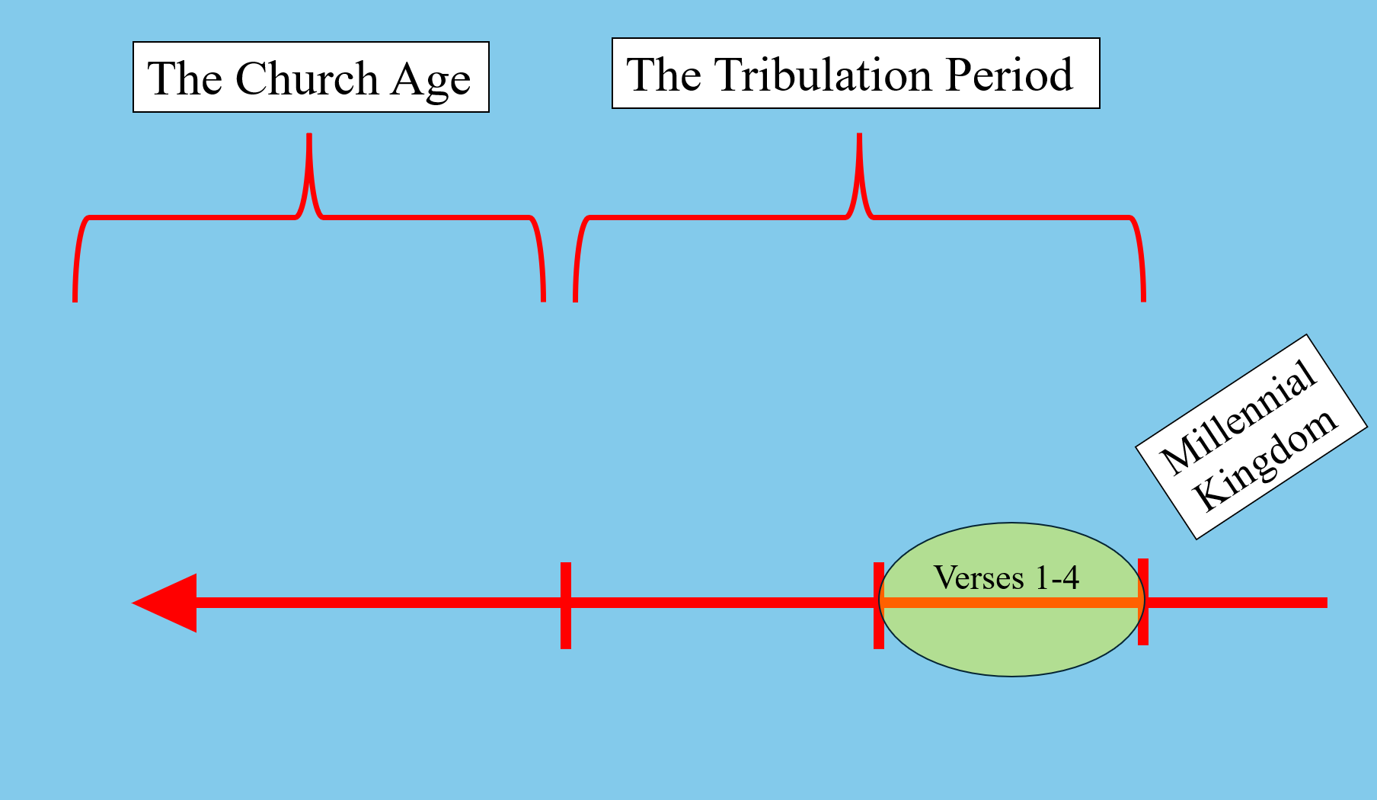

Slide 9
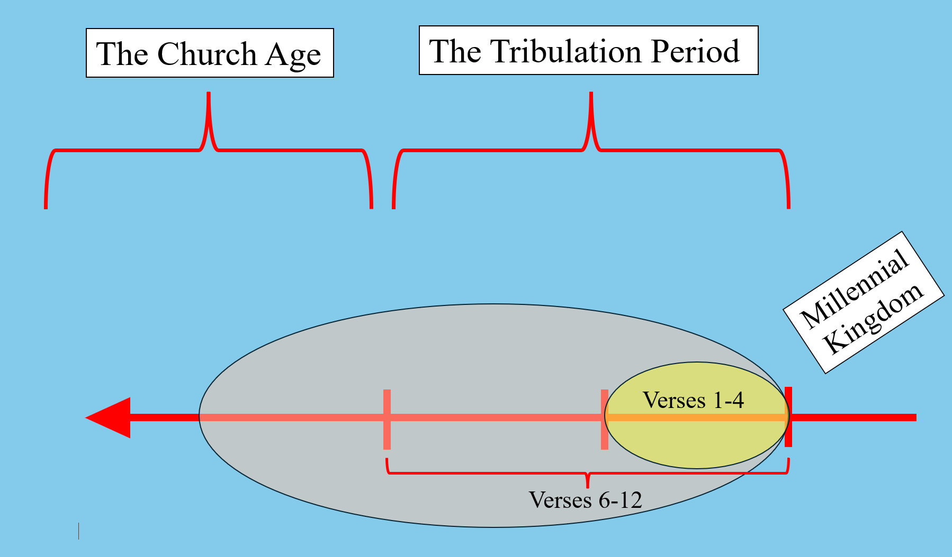

Slide 10
2 Thessalonians 2:6-7
“And now you know what is restraining, that he may be revealed in his own time. For the mystery of lawlessness is already at work; only He who now restrains will do so until He is taken out of the way.”

Slide 11
2 Thessalonians 2:6-7
“And now you know what is restraining, that he may be revealed in his own time. For the mystery of lawlessness is already at work; only He who now restrains will do so until He is taken out of the way.”

Slide 12
2 Thessalonians 2:6-7
“And now you know what is restraining, that he may be revealed in his own time. For the mystery of lawlessness is already at work; only He who now restrains will do so until He is taken out of the way.”

Slide 13
2 Thessalonians 2:6-7
“And now you know what is restraining, that he may be revealed in his own time. For the mystery of lawlessness is already at work; only He who now restrains will do so until He is taken out of the way.”

Slide 14
2 Thessalonians 2:6-7
“And now you know what is restraining, that he may be revealed in his own time. For the mystery of lawlessness is already at work; only He who now restrains will do so until He is taken out of the way.”

Slide 15
Psalm 51:1-5
“Have mercy upon me, O God, according to Your lovingkindness; according to the multitude of Your tender mercies, blot out my transgressions. Wash me thoroughly from my iniquity, and cleanse me from my sin. For I acknowledge my transgressions, and my sin is always before me.

Slide 16
Psalm 51:1-5
Against You, You only, have I sinned, and done this evil in Your sight – that You may be found just when You speak, and blameless when You judge. Behold, I was brought forth in iniquity, and in sin my mother conceived me.”

Slide 17
Psalm 51:1-5
Against You, You only, have I sinned, and done this evil in Your sight – that You may be found just when You speak, and blameless when You judge. Behold, I was brought forth in iniquity, and in sin my mother conceived me.”

Slide 18
2 Thessalonians 2:6-7
“And now you know what is restraining, that he may be revealed in his own time. For the mystery of lawlessness is already at work; only He who now restrains will do so until He is taken out of the way.”

Slide 19
2 Thessalonians 2:6-7
“And now you know what is restraining, that he may be revealed in his own time. For the mystery of lawlessness is already at work; only He who now restrains will do so until He is taken out of the way.”

Slide 21
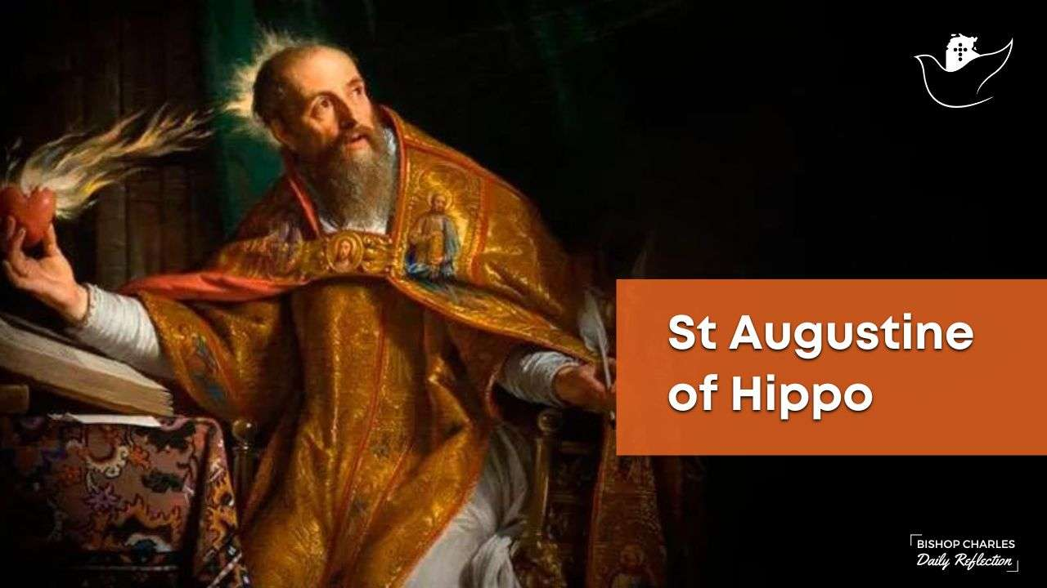

Slide 22
Ideas on “Who” the restrainer is:
The Roman Empire
The Jewish State
The Apostle Paul
The Preaching of the Gospel
Human Government
Satan
Elijah
Unfallen Angels
Michael the Archangel
The Holy Spirit
The Church

Slide 23
Ideas on “Who” the restrainer is:
Human Government
The Church
The Preaching of the Gospel
The Holy Spirit

Slide 24
Romans 13:1-4
“Let every soul be subject to the governing authorities. For there is no authority except from God, and the authorities that exist are appointed by God. Therefore whoever resists the authority resists the ordinance of God, and those who resist will bring judgment on themselves. For rulers are not a terror to good works, but to evil.

Slide 25
Romans 13:1-4
Do you want to be unafraid of the authority? Do what is good, and you will have praise from the same. For he is God’s minister to you for good. But if you do evil, be afraid; for he does not bear the sword in vain; for he is God’s minister, an avenger to execute wrath on him who practices evil.”

Slide 26
Romans 13:1-4
Do you want to be unafraid of the authority? Do what is good, and you will have praise from the same. For he is God’s minister to you for good. But if you do evil, be afraid; for he does not bear the sword in vain; for he is God’s minister, an avenger to execute wrath on him who practices evil.”

Slide 27
1 Peter 2:13-14
“Therefore submit yourselves to every ordinance of man for the Lord’s sake, whether to the king as supreme, or to governors, as to those who are sent by him for the punishment of evildoers and for the praise of those who do good.”

Slide 28
Ephesians 2:2
“… in which you once walked according to the course of this world, according to the prince of the power of the air, the spirit who now works in the sons of disobedience.”
Satan

Slide 29
Is the church the restrainer?

Slide 30
Is the church the restrainer?
The church has had a role in holding back the spiritual forces of darkness through prayer, evangelism throughout the world, efforts in discipleship and in simply speaking the truth throughout the four corners of the globe.

Slide 31
2 Thessalonians 2:6-7
“And now you know what is restraining, that he may be revealed in his own time. For the mystery of lawlessness is already at work; only He who now restrains will do so until He is taken out of the way.”

Slide 32
Is the Holy Spirit the restrainer?
Clues to look at …

Slide 33
Is the Holy Spirit the restrainer?
Clues to look at …
The restrainer holds back the man of sin

Slide 34
Is the Holy Spirit the restrainer?
Clues to look at …
The restrainer holds back the man of sin
The grammar used in verses 6 and 7

Slide 35
“… ‘what’ is restraining …”
Because of the noun ‘what’, the verb
‘restraining’ is in the neuter form

Slide 36
“… ‘what’ is restraining …”
‘what’ then suggests a principle as
opposed to a person doing the action
Because of the noun ‘what’, the verb
‘restraining’ is in the neuter form

Slide 37
“… ‘what’ is restraining …”
‘what’ then suggests a principle as
opposed to a person doing the action
“… ‘He’ who now restrains …”
Because of the noun ‘what’, the verb
‘restraining’ is in the neuter form
Because of the noun ‘He’, the verb
‘restrains’ is in the masculine form

Slide 38
“… ‘what’ is restraining …”
‘what’ then suggests a principle as
opposed to a person doing the action
“… ‘He’ who now restrains …”
The masculine verb suggests a person
Because of the noun ‘what’, the verb
‘restraining’ is in the neuter form
Because of the noun ‘He’, the verb
‘restrains’ is in the masculine form

Slide 39
Is the Holy Spirit the restrainer?
Clues to look at …
The restrainer holds back the man of sin
The grammar used in verses 6 and 7
Whatever the restrainer is, he or it must be removable

Slide 40
2 Thessalonians 2:6-7
“And now you know what is restraining, that he may be revealed in his own time. For the mystery of lawlessness is already at work; only He who now restrains will do so until He is taken out of the way.”

Slide 41
Is the Holy Spirit the restrainer?
Clues to look at …
The restrainer holds back the man of sin
The grammar used in verses 6 and 7
Whatever the restrainer is, he or it must be removable
The restrainer must be powerful enough to hold back the outbreak of evil under the antichrist

Slide 42
The restrainer must be God Himself … and that would be God the Holy Spirit – the third Person of the Trinity.

Slide 43
The restrainer must be God Himself … and that would be God the Holy Spirit – the third Person of the Trinity.
BUT …

Slide 44
The restrainer must be God Himself … and that would be God the Holy Spirit – the third Person of the Trinity.
BUT …
Some Questions Remain …

Slide 45
Why would the Holy Spirit be referred to
as both a principle and as a person …
like a “what” and a “who”?

Slide 46
Why would the Holy Spirit be referred to as both a principle and as a person …
like a “what” and a “who”?
How can the Holy Spirit, who is
omnipresent (everywhere at the same
time), be removed from the earth?

Slide 47
If the Holy Spirit were removed from the
earth, then how could people be saved
during the Tribulation period?

Slide 48
John 3:3, 5
“Most assuredly, I say to you, unless one is born again, he cannot see the kingdom of God.”
“Most assuredly, I say to you, unless one is born of water and the Spirit, he cannot enter the kingdom of God.”

Slide 49
Revelation 7:9-14
“After these things I looked, and behold, a great multitude which no one could number, of all nations, tribes, peoples, and tongues, standing before the throne and before the Lamb, clothed with white robes, with palm branches in their hands, and crying out with a loud voice, saying, “Salvation belongs to our God who sits on the throne, and to the

Slide 50
Revelation 7:9-14
Lamb!” All the angels stood around the throne and the elders and the four living creatures, and fell on their face before the throne and worshiped God, saying: “Amen! Blessing and glory and wisdom, thanksgiving and honor and power and might, be to our God forever and ever. Amen.” Then one of the elders answered,

Slide 51
Revelation 7:9-14
saying to me, “Who are these arrayed in white robes, and where did they come from?” And I said to him, “Sir, you know.” So he said to me, “These are the ones who come out of the great tribulation, and washed their robes and made them white in the blood of the lamb.”

Slide 52
John 16:7-11
“Nevertheless I tell you the truth. It is to your advantage that I go away; for if I do not go away, the Helper will not come to you; but if I depart, I will send Him to you. And when He has come, He will convict the world of sin, and of

Slide 53
John 16:7-11
righteousness, and of judgment: of sin, because they do not believe in Me; of righteousness, because I go to My Father and you see Me no more; of judgment, because the ruler of this world is judged.”

Slide 54
The restrainer isn’t one thing or the other – i.e., the Holy Spirit or the church, but that it is a combination of the two. In other words, the restrainer that Paul is speaking of must be the Spirit-Indwelt Church.

Slide 55
2 Thessalonians 2:6-7
“And now you know what is restraining, that he may be revealed in his own time. For the mystery of lawlessness is already at work; only He who now restrains will do so until He is taken out of the way.”

